Slide 1
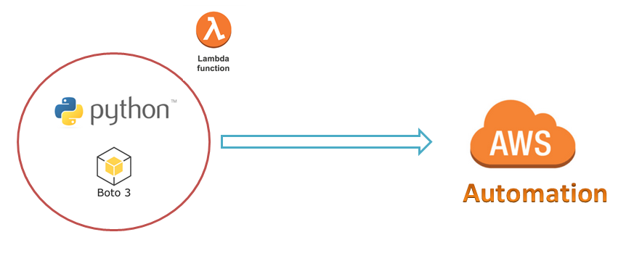
AWS Automation
with
boto3 of Python and Lambda Functions
Concepts of boto3
Loop control statements or commands
(break and continue)
Learn how to automate AWS common tasks using boto3 and Lambda

Slide 2

Concepts of boto3
Session
Resource
Client
Meta
Collections
Waiters
Paginators
Loop control statements or commands
(break and continue)
Learn how to automate AWS common tasks using boto3 and Lambda

Slide 3
Boto3 Environment setup on Linux Server…
Configure credentials of your AWS account on windows server using awscli commands.
Install awscli
pip3 install awscli
Configure root/IAM user access-keys/credentials using:
aws configure --profile root
aws configure --profile non_prod
aws configure --profile prod
Loop control statements or commands
(break and continue)
Learn how to automate AWS common tasks using boto3 and Lambda

Slide 4
Thank you

